Slide 1
BOOSTING ALGORITHM

Slide 2
Types of Boosting Algorithm:
Ada Boost
XG Boosting
LG Boosting

Slide 3
Ada Boost:
Same Work as Normal Boosting Algorithm
Transforming Weak Learners into Strong Learners
By Giving Incremental Weight Concepts
Used For Both Classification and Regression Problems

Slide 4
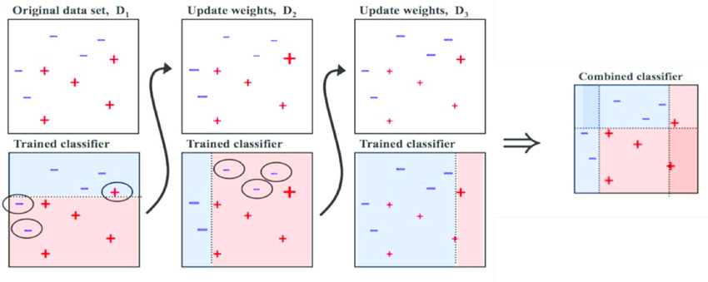
AdaBoost Regression uses several weak regression models. It improves the overall prediction performance by continually modifying the weights of the training classifiers to concentrate on factors that are challenging to forecast.

Slide 5
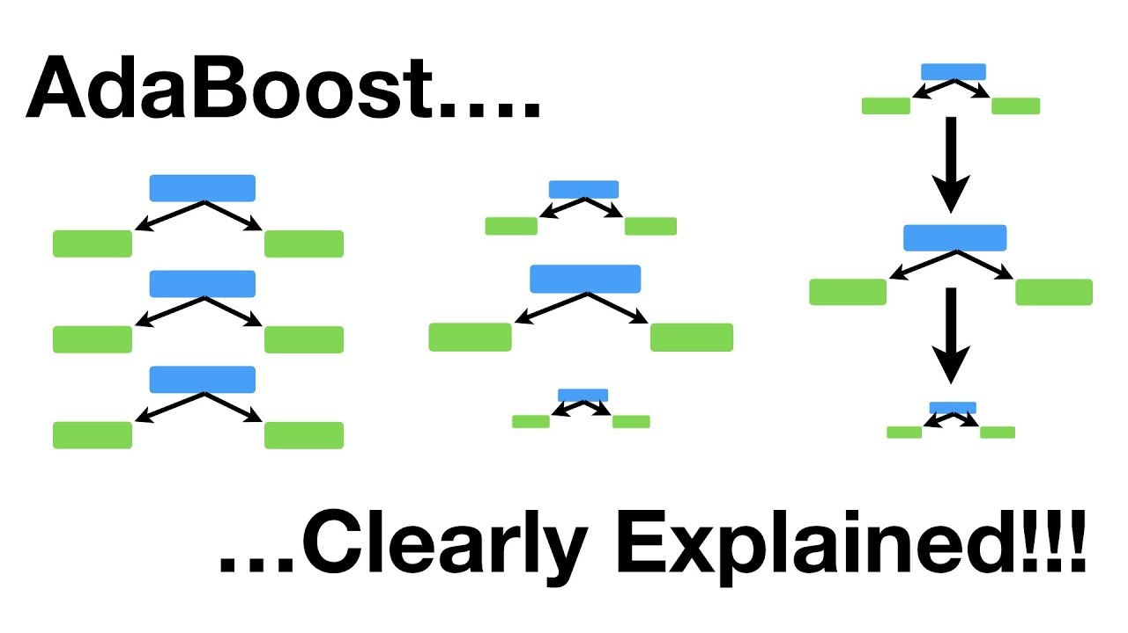

Slide 6
During the prediction phase, AdaBoost combines the predictions of all the weak learners. Each weak learner's prediction is weighted based on its performance, giving more weight to the learners that performed better.
The final prediction is obtained by summing these weighted predictions.

Slide 7
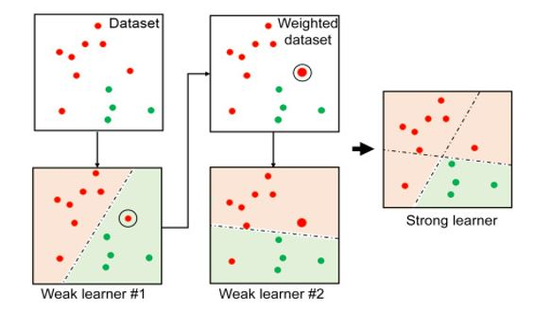
Algorithms from Ada boost are popularly used in regression and classification procedures. An error noticed in previous dataset models are adjusted with weighting until an accurate prediction is made.

